Slide 1
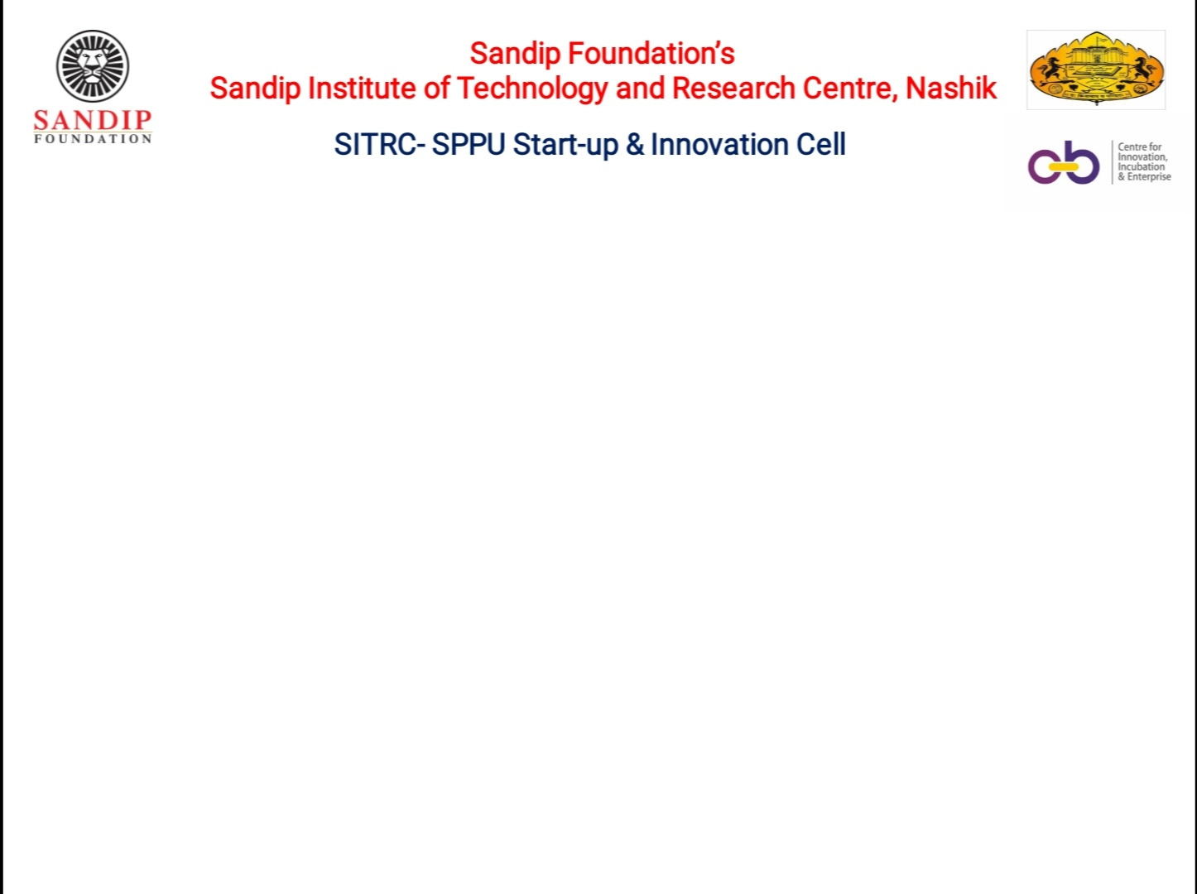

Department of Electronics and Telecommunication (E&TC) Engineering Academic Year 2021-22
A PROJECT PRESENTATION ON
IoT Based Hi-Tech Onion Farming
BY
1. SHAHZEB HUSAIN SHAIKH
2. YOGESH SONAWANE
GUIDED BY
Dr. Mrs. G. M. PHADE
A PROJECT PRESENTATION ON
IoT Based Hi-Tech Onion Farming
BY
1. SHAHZEB HUSAIN SHAIKH
2. YOGESH SONAWANE
GUIDED BY
Dr. Mrs. G. M. PHADE

Slide 2
INDEX
Introduction
Problem statement
Literature survey
Objective
Block diagram
Flowchart
Methodology
Hardware/Software
Advantages
Conclusion
Future scope
References

Slide 3
INTRODUCTION
The project “IoT Based Hi-Tech farming” is based on remote monitoring of different environmental parameters like temperature, humidity, ambient light, soil moisture, etc.
This system also integrates the automatic irrrigation system which will provide the water to the farm automatically only when the soil moisture level of a farm goes below the pre-decided threshold level.
With this we can make effecient use of water and can avoid the wastage of it.
And by measuring variuous enviromental parameters, a farmer can make better decisions for his farm for better growth with less amount of resources.

Slide 4
PROBLEM STATEMENT
Onions, being a significant ingredient, the change in prices have huge impact on food security and farmers and consumer welfare.
This crop is also affected by low productivity due to factors like unprecedented climate crisis which if left unattended may result in crop damage. The price of onions is dependent on the productivity of onion.
India is the second largest onion growing country in the world. Indian onions are famous for their pungency and are available round the year, Its yield is affected due to climatic conditions like temperature, humidity, moisture.
To improve the yield farmers uses excessive use of chemical fertilizers which may decay the soil fertility

Slide 5
LITERATURE SURVEY
Sr. no. | Year | Title | Author Name | Methodology | Outcome | Drawbacks
1 | 2016 | Precision Farming: The Future of Indian Agriculture.[1] | V. M. Abdul Hakki m, E. Abhilash Joseph, A. J. Ajay Gokul and K. Mufeedha | Electronic Sensors, Information Technology and Management | Early orediction of dicease, effecient use of resources, better growth and more profit. | Need to provide water manually.
2 | 2018 | Precision Agriculture: A Modern Approach To Smart Farming[2] | Mr. Akshay Mehta, Mr. Monish Masdekar | Utilising Sensors and existing technologies | Economic and environmental issues that surround agriculture production today. | Lack of information , connectivity problems in remote areas and lack of financial support.

Slide 6
LITERATURE SURVEY
Sr. no. | Year | Title | Author Name | Methodology | Outcome | Drawbacks
3 | 2015 | Implementation of an Automated Irrigation System [3] | U N V P Rajendranath, Dr. V. Berlin Hency | Sensors, Arduino board and SIM900A module | SMS alert of soil moisture and other environmental parameters on exceeding of threshold level. | Water supply is not automated.
4 | 2016 | Automatic Irrigation System for Agriculture Feild Using Wireless Sensor Network (WSN)[4] | Prof. Rashmi8 Jain, Shaunak Kulkarni, Ahtesham Shaikh, Akash Sood | Automatic Water Supply to the farm | Efficient use of water. . | Don’t have mobile application. .

Slide 7
OUTCOME OF LITERATURE SURVEY
WIRELESS FIELD MONITORING
AUTOMATIC IRRIGATION SYSTEM

Slide 8
OBJECTIVE
To collect the data from sensor regarding different field parameters like Temperature, humidity, Environment and Soil Moisture and Ambient light
To control the existing irrigation system cost effectively
To prescribe a fertilizer management system with appropriate dosage.
To develop a mobile app for monitoring the field parameter and give the related predictions and alerting the farmers of possible diseases that can occur.
To Help Farmer community

Slide 9
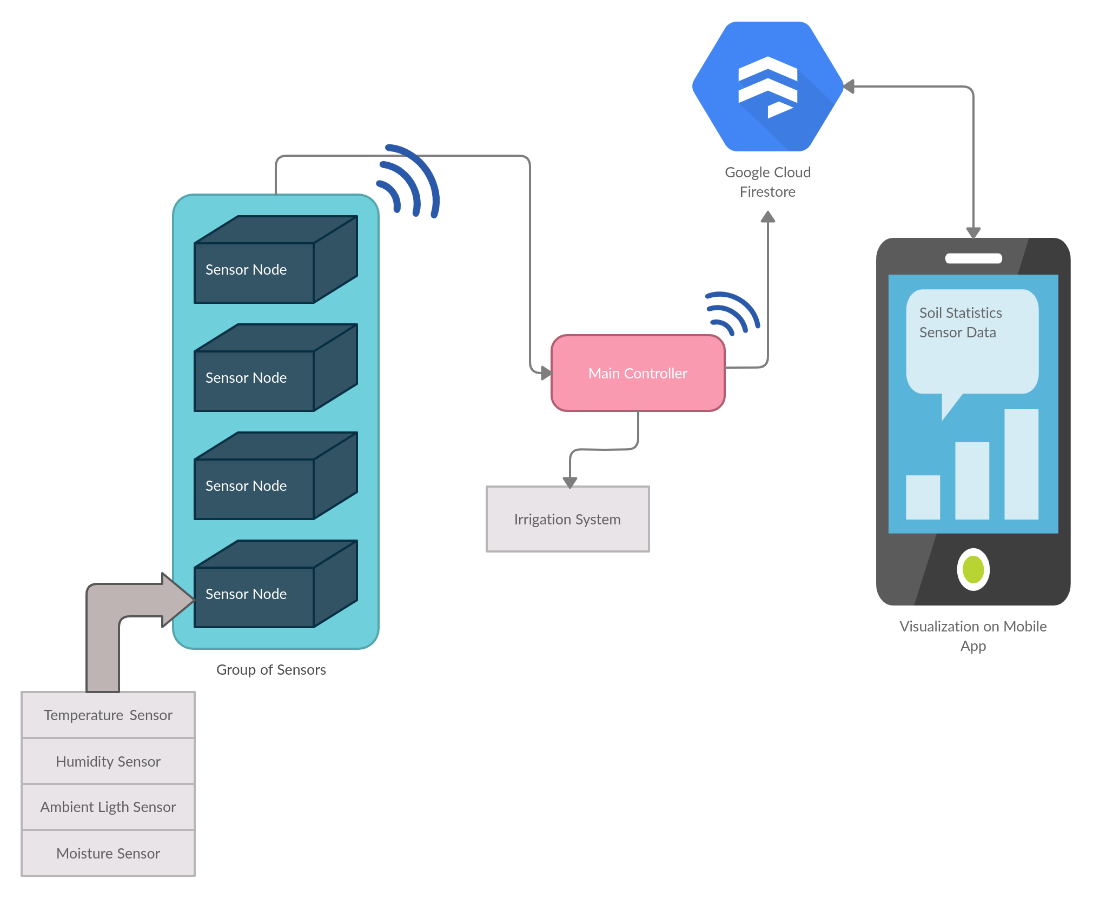
BLOCK DIAGRAM

Slide 10
FLOWCHART
SENSOR DATA
MAKING DECISION FOR IRRIGATION
SENDING DATA TO DATABASE
ACCESSING DATA ONB MOBILE APP

Slide 11
METHODOLOGY
2.Technology overview 3.Application development
4. Data Storage on Google Firebase
5.Execution
1. Literature Survey

Slide 12
1.Literature Survey
Need and current work on the system.
2.Technology overview
Existing methods for remote monitoring
3.Application development
GUI based App indicates various environmental parameters. 4.Data Storage on Google Firebase collection and storage of data for future reference
5.Execution
Debugging,Testing and Results (Remain)
METHODOLOGY

Slide 13
Hardware/Software
Software :
Arduino IDE
Flutter
Google Firebase as Database to store the history of collected data.
Hardware :
Arduino Uno, ESP8266, BME280, BH1750, 5V Relay module, BC547, 4V Solar Panel, Lithium Ion battery.
Capacitive type soil moisture sensor, etc

Slide 14
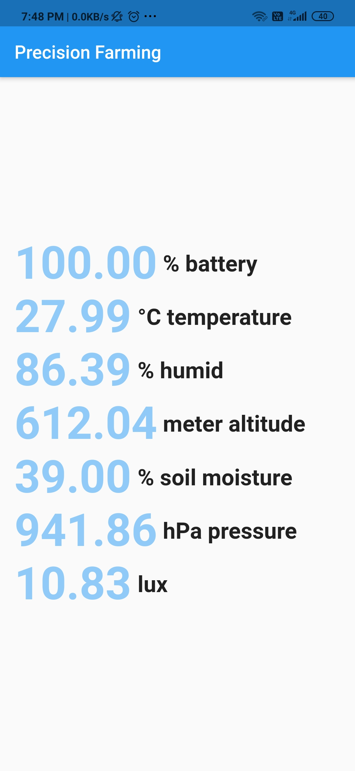
MOBILE APPLICATION:

Slide 15
ADVANTAGES
Will increase agriculture productivity.
Will avoid soil degradation.
Will reduce chemical application in crop production.
Will make efficient use of water resourses.
Will change the socio-economic status of farmers.
Will provide ease for new commers in agriculture.

Slide 16
Conclusion
With this system we can achieve the remote monitoring of our farm and with efficient use of inputs better growth and good earning would be achieve.

Slide 17
FUTURE SCOPE
We can use image processing technology for more accurate prediction of disease to be ocuured.

Slide 18
REFERENCES
[1]V. M. Abdul Hakkim, E. Abhilash joseph, A. J. Ajay Gokul, K. Mufeedha &quot;Precision Farming: The Future of Indian Agriculture & quot;, Journal of Applied Biology & Biotechnology(068-072), Volume
4– No.06, Nov-Dec, 2016.
[2]Mr. Akshay Mehta, Mr. Monish Masdekar," Precision Agriculture – A Modern Approach To Smart Farming ,"International Journal of Scientific & Engineering Research Volume 9, Issue 2, February-2018.
[3] U N V P Rajendranath, Dr. V. Berlin Hency, &Implementation of an Automated Irrigation System& quot; IEEE Sponsored 2nd International Conference on Innovations in Information, Embedded and Communication systems (ICIIECS)2015.
[4]Prof. Rashmi Jain, Shaunak Kulkarni, Ahtesham Shaikh, Akash Sood, “ Automatic irrigation system for agriculture field using wireless sensor network (wsn) ”, International Research Journal of Engineering and Technology (IRJET) ,Vol 03. p-ISSN: 2395-0072 ,2016.

Slide 19
THANK YOU…

